Slide 1
NEO-KONG 1.0 NEO Key-Object Notation for Geeks
NEO Community TechNote
Michael Herman
https://github.com/mwherman2000/neo-persistibleclasses
neotoronto@outlook.com

Slide 2
Agenda
Purpose
Scenario
Problem
Analysis
Options
Solution
Code
Results
Future Work
Summary

Slide 3
1. Purpose
The purpose of this NEO Community Tech Note presentation is …

Slide 4
2. Scenario
The initial set of user scenarios and use cases include:
TODO
TODO
TODO

Slide 5
3. Problem
The problem this Tech Note address is …

Slide 6
4. Analysis
TODO
TODO
TODO

Slide 7
5. Options
The options for addressing the problem based on the analysis include:
TODO
TODO
TODO

Slide 8
6. Solution
From the available options, the selected solution is …

Slide 9
7. Code

Slide 10
8. Results

Slide 11
9. Future Work

Slide 12
10. Summary

Slide 13
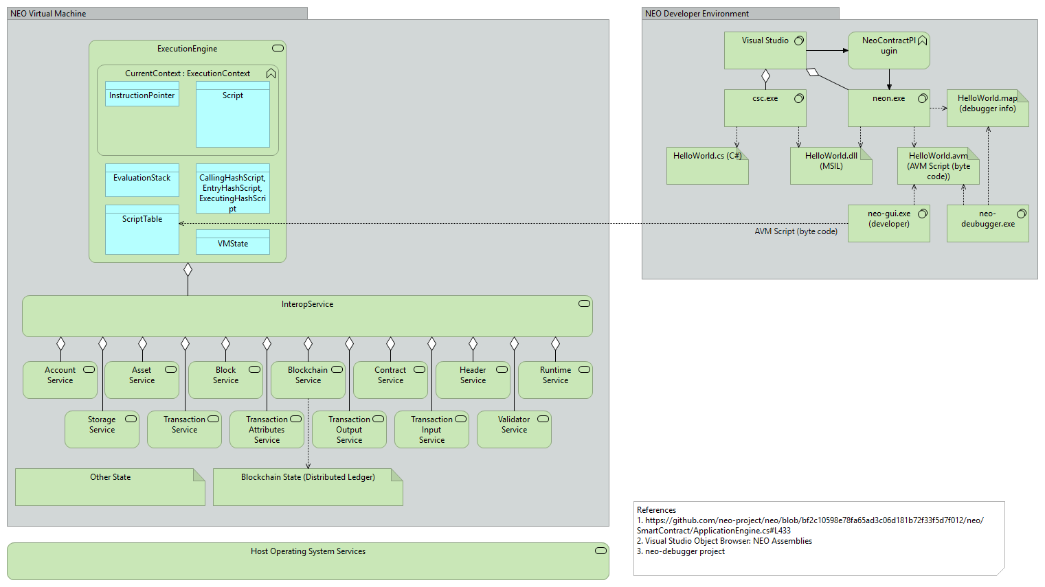
A. NEO Blockchain Architecture Reference Model (ARM

Slide 14
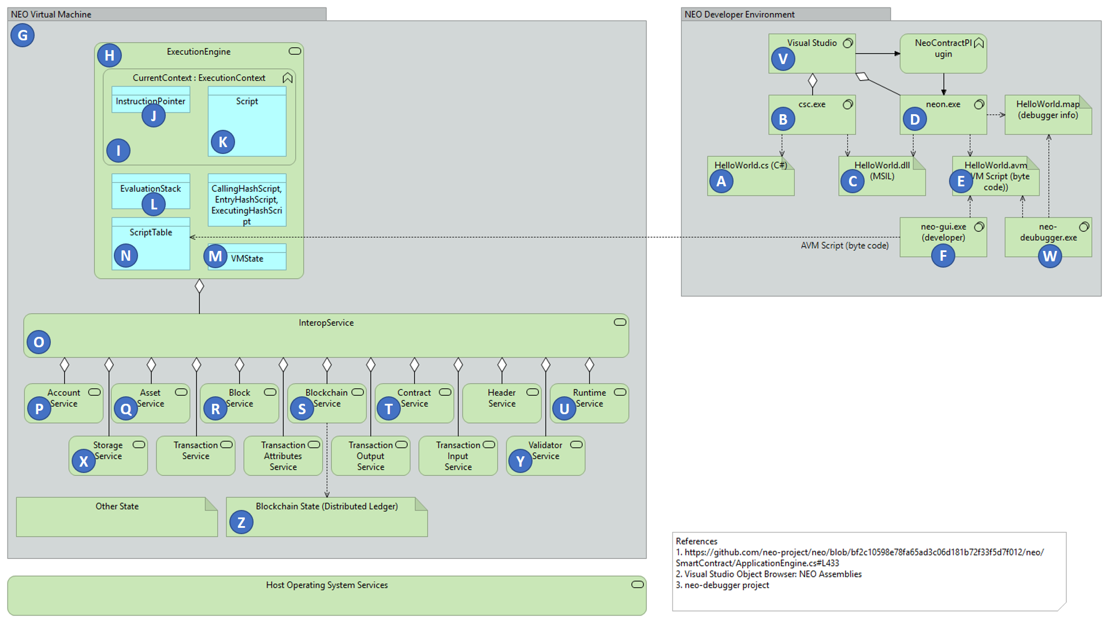
NEO Blockchain ARM

Slide 15
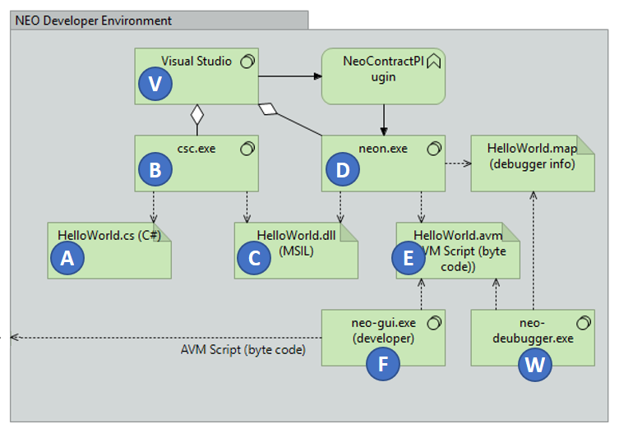
NEO Developer Environment

Slide 16
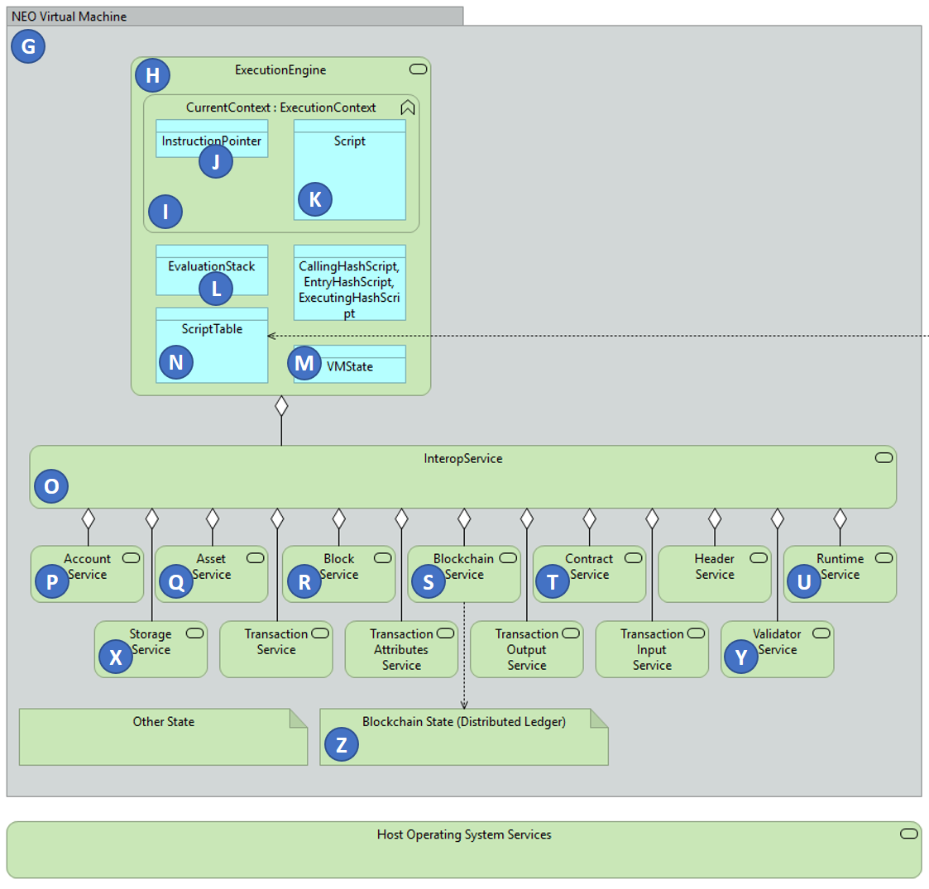
NEO Virtual Machine

Slide 17
Questions?
neotoronto@outlook.com

